Slide 1
Interprocess Communication

Slide 2
Interprocess Communication
Consider shell pipeline
cat chapter1 chapter2 chapter3 | grep tree
2 processes
Information sharing
Order of execution

Slide 3
Interprocess Communication
Processes within a system may be independent or cooperating
Cooperating process can affect or be affected by other processes
Reasons for cooperating processes:
Information sharing
Computation speedup
Modularity
Convenience
Cooperating processes require a mechanism to exchange data and information

Slide 4
IPC issues
How one process passes information to another ?
How to make sure that two or more processes do not get into each other’s way when engaging in critical activities?
How to do proper sequencing when dependencies are present?
Ans 1: easy for threads, for processes different approaches (e.g., message passing, shared memory)
Ans 2 and Ans 3: same problems and same solutions apply for threads and processes
Mutual exclusion & Synchronization
11/17/2018
Dept. of CSE, BUET

Slide 5
Spooling Example: Correct
Process 1
Shared memory
Process 2
int next_free;
int next_free;
…
out
1
next_free = in;
4
abc
2
Stores F1 into next_free;
Prog.c
5
6
Prog.n
3
in=next_free+1
in
7
F1
4
next_free = in
F2
5
Stores F2 into next_free;
…
6
in=next_free+1
11/17/2018
Dept. of CSE, BUET

Slide 6
Spooling Example: Races
Process 1
Shared memory
Process 2
int next_free;
int next_free;
…
out
1
next_free = in;
4
abc
5
Prog.c
2
next_free = in
/* value: 7 */
3
Stores F1 into next_free;
Prog.n
6
in
7
F1
F2
4
in=next_free+1
5
Stores F2 into next_free;
…
6
in=next_free+1
11/17/2018
Dept. of CSE, BUET

Slide 7
Better Coding?
In previous code
for(;;){
int next_free = in;
slot[next_free] = file;
in = next_free+1;
}
What if we use one line of code?
for(;;){
slot[in++] = file
}
11/17/2018
Dept. of CSE, BUET

Slide 8
When Can process Be switched?
After each machine instruction!
in++ is a C/C++ statement, translated into three machine instructions:
load mem, R
inc R
store R, mem
Interrupt (and hence process swichting) can happen in between.
11/17/2018
Dept. of CSE, BUET

Slide 9
Race condition
Two or more processes are reading or writing some shared data and the final result depends on who runs precisely when
Very hard to Debug

Slide 10
Critical Region
That part of the program that do critical things such as accessing shared memory
Can lead to race condition

Slide 11
Solution Requirement
No two processes simultaneously in critical region
No assumptions made about speeds or numbers of CPUs
No process running outside its critical region may block another process
No process must wait forever to enter its critical region

Slide 12
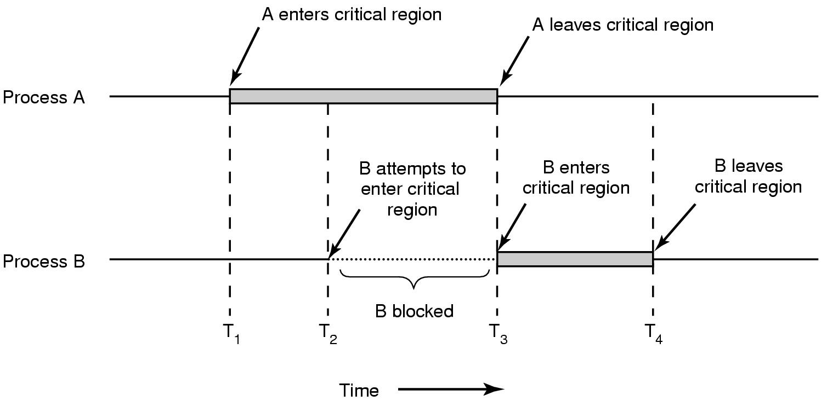
Solution Requirement

Slide 13
Mutual exclusion With Busy Waiting
Possible Solutions
Disabling Interrupts
Lock Variables
Strict Alternation
Peterson’s solution
TSL
11/17/2018
Dept. of CSE, BUET

Slide 14
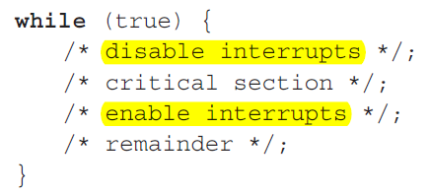
Disabling Interrupts
How does it work?
Disable all interrupts just after entering a critical section
Re-enable them just before leaving it.
Why does it work?
With interrupts disabled, no clock interrupts can occur
No switching can occur
Problems:
What if the process forgets to enable the interrupts?
Multiprocessor? (disabling interrupts only affects one CPU)
11/17/2018
Dept. of CSE, BUET

Slide 15
Lock Variables
int lock = 0;
while (lock);
lock = 1;
//EnterCriticalSection;
access shared variable;
//LeaveCriticalSection;
lock = 0;
Does the above code work?
11/17/2018
Dept. of CSE, BUET

Slide 16
Lock Variables
int lock = 0;
while (lock);
Check again here?
lock = 1;
//EnterCriticalSection;
access shared variable;
//LeaveCriticalSection;
lock = 0;
Still doesn’t work!
11/17/2018
Dept. of CSE, BUET

Slide 17
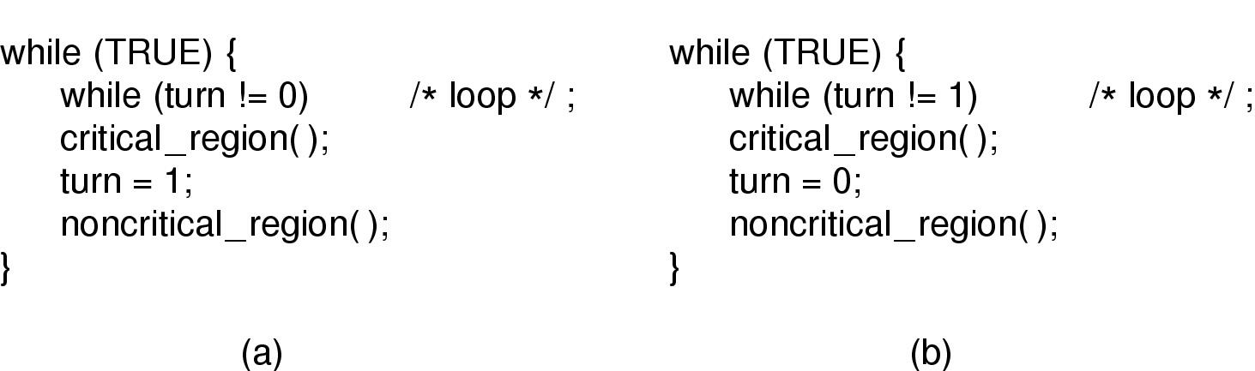
Strict Alternation
Process 0 (b) Process 1
Proposed solution to critical region problem

Slide 18
Problem
Busy waiting: Continuously testing a variable until some value appear
Wastes CPU time
Violates condition 3
When one process is much slower than the other

Slide 19
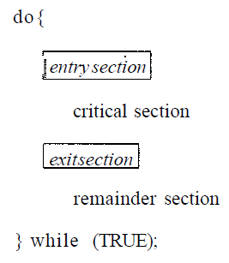
Peterson's solution
Consists of 2 procedures
Each process has to call
enter_region with its own process # before entering its C.R.
And Leave_region after leaving C.R.
enter_region(process#)
leave_region(process#)

Slide 20
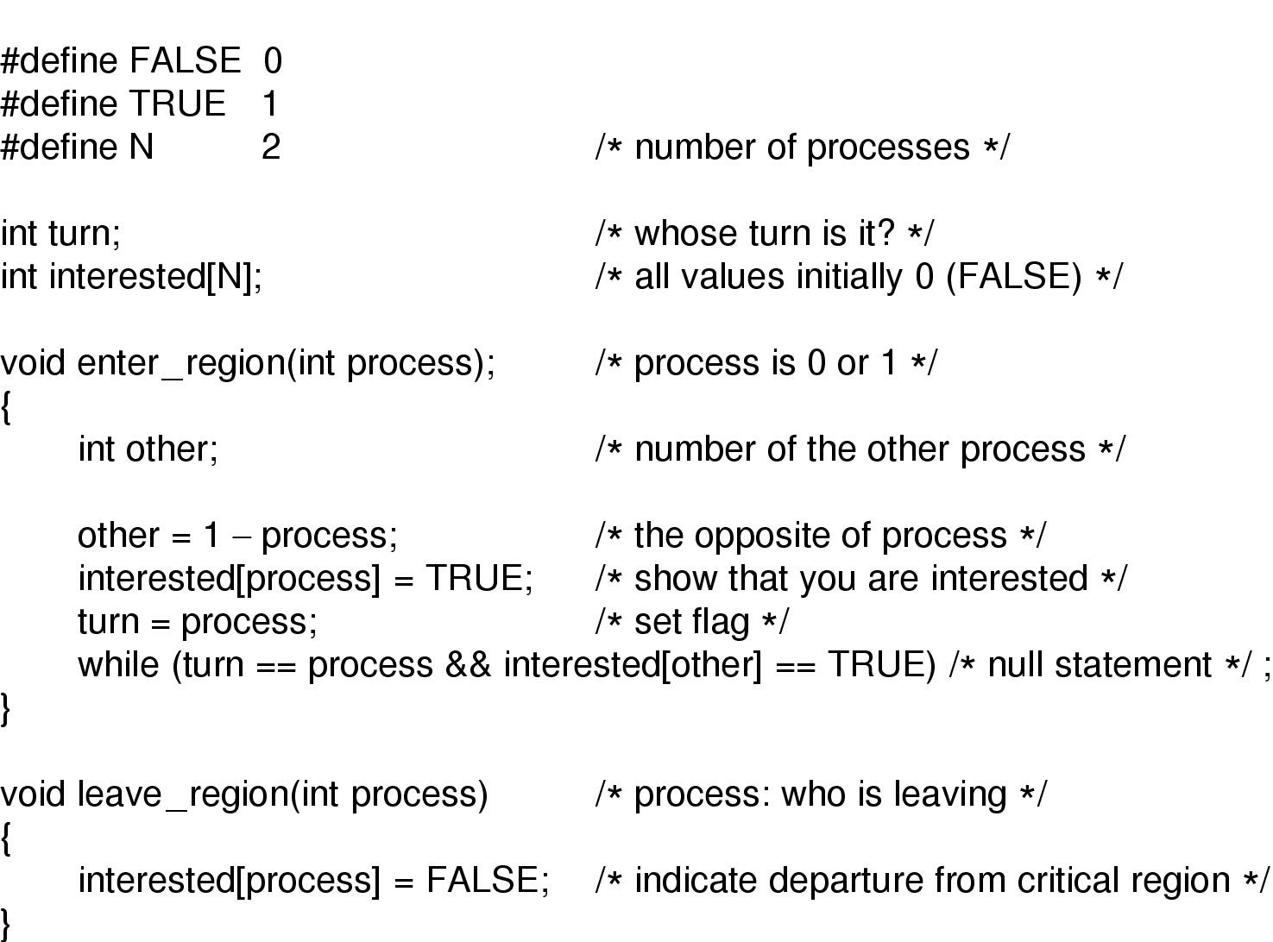
Peterson's solution (for 2 processes)

Slide 21
Peterson’s Solution: Analysis(1)
Let Process 1 is not interested and Process 0 calls enter_region with 0
So, turn = 0 and interested[0] = true and Process 0 is in CR
Now if Process 1 calls enter_region, it will hang there until interested[0] is false. Which only happens when Process 0 calls leave_region i.e. leaves the C.R.

Slide 22
Peterson’s Solution: Analysis(2)
Let both processes call enter_region simultaneously
Say turn = 1. (i.e. Process 1 stores last)
Process 0 enters critical region: while (turn = = 0 && …) returns false since turn = 1.
Process 1 loops until process 0 exits: while (turn = = 1 && interested[0] = = true) returns true.
It works fine!!

Slide 23
Busy Waiting: Problems
Waste CPU time since it sits on a tight loop
May have unexpected effects:
Priority Inversion Problem
Example:
2 Cooperating Processes: H (high priority ) and L (low priority )
Scheduling rule: H is run whenever it is ready
Let L in C. R. and H is ready and wants to enter C.R.
Since H is ready it is given the CPU and it starts busy waiting
L will never gets the chance to leave its C.R.
H loops forever

Slide 24
Sleep & wakeup
When a process has to wait, change its state to BLOCKED
Switched to READY state, when it is OK to retry entering the critical section
Sleep is a system call that causes the caller to block
be suspended until another process wakes it up
Wakeup system call has one parameter, the process to be awakened.
Let’s illustrate the use of sleep & wakeup with an example: The producer consumer problem

Slide 25
Producer Consumer Problem
Also called bounded-buffer problem
Two (or m+n) processes share a common buffer
One (or m) of them is (are) producer(s): put(s) information in the buffer
One (or n) of them is (are) consumer(s): take(s) information out of the buffer
Trouble and solution
Producer wants to put but buffer full- Go to sleep and wake up when consumer takes one or more
Consumer wants to take but buffer empty- go to sleep and wake up when producer puts one or more

Slide 26
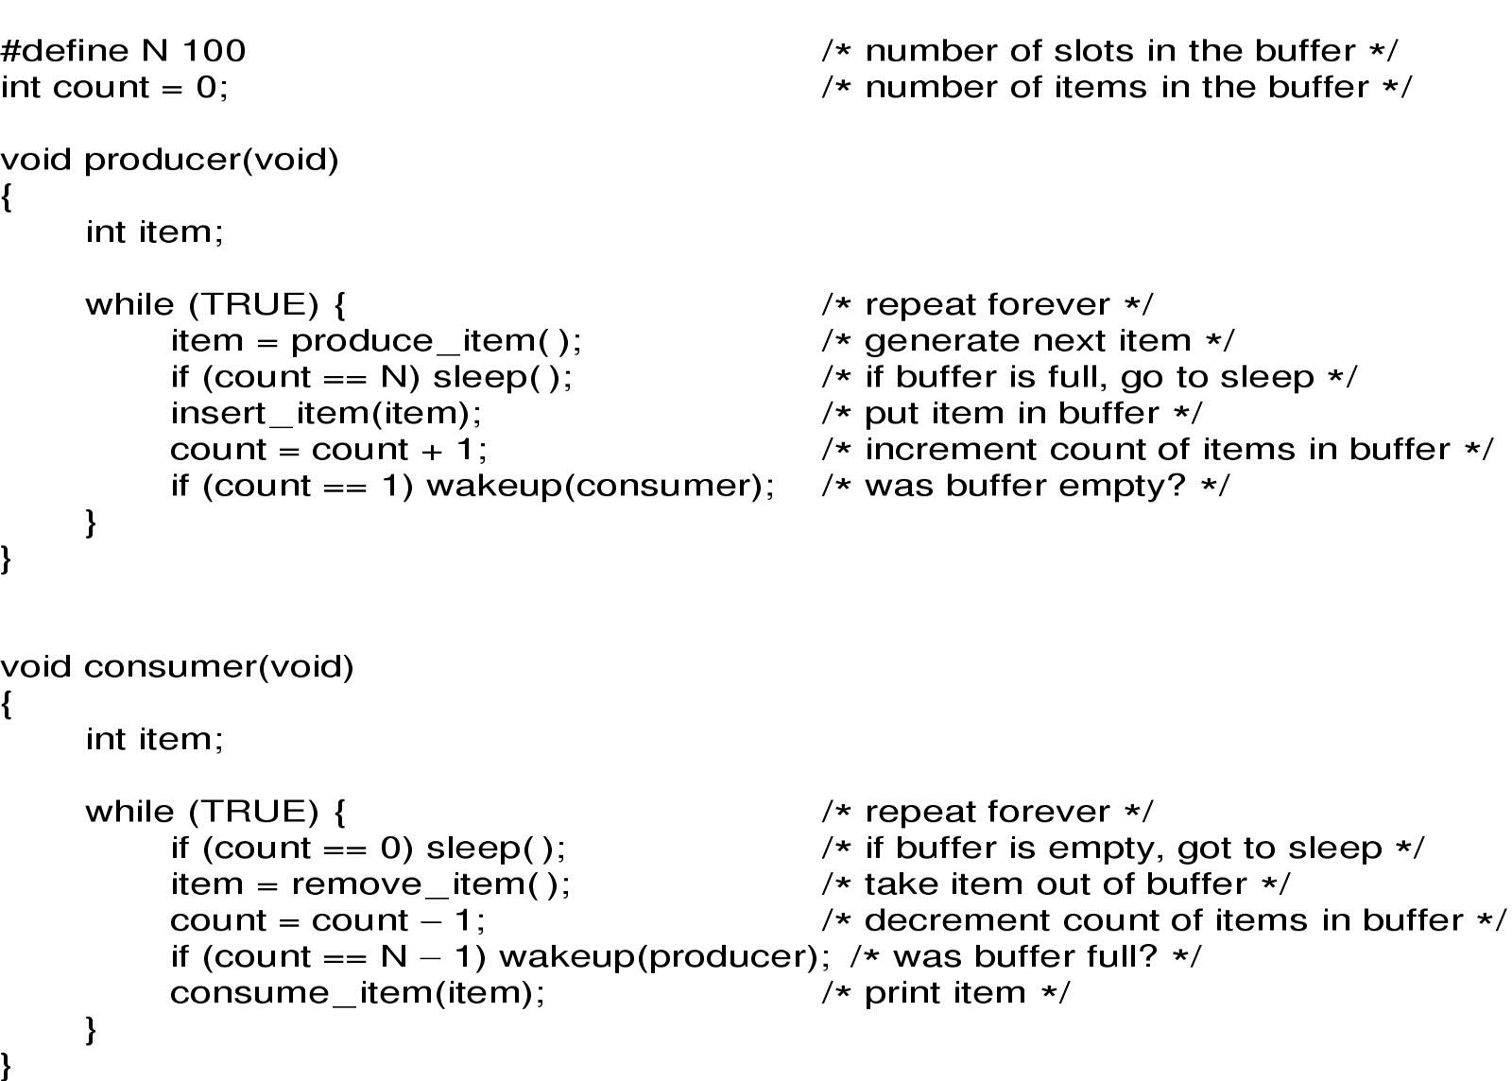
Sleep and Wakeup

Slide 27

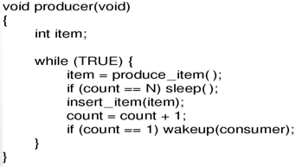
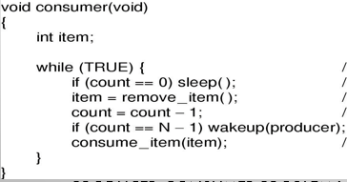
Sleep and Wakeup
Producer-consumer problem

Slide 28
Sleep and Wakeup: Race condition
Busy waiting problem is resolved but the following race condition exists
Unconstrained access to count
CPU is given to P just after C has read count to be 0 but not yet gone to sleep.
P calls wakeup
Result is lost wake-up signal
Both will sleep forever

Slide 29

Semaphores
A new variable type
A kind of generalized lock
First defined by Dijkstra in late 60s
Main synchronization primitive used in original UNIX
Semaphores are like integers, except
No negative values
Only operations allowed are up and down – can’t read or write value, except to set it initially

Slide 30
Semaphores: Types
Counting semaphore.
The value can range over an unrestricted domain
Binary semaphore
The value can range only between 0 and 1.
On some systems, binary semaphores are known as mutex locks as they provide mutual exclusion

Slide 31
Semaphores: Operation
Operation “down”:
if value > 0; value-- and then continue.
if value = 0; process is put to sleep without completing the down for the moment
Checking the value, changing it, and possibly going to sleep, is all done as an atomic action.
Operation “up”:
increments the value of the semaphore addressed.
If one or more process were sleeping on that semaphore, one of them is chosen by the system (e.g. at random) and is allowed to complete its down
The operation of incrementing the semaphore and waking up one process is also indivisible
No process ever blocks doing an up.

Slide 32
Semaphores: Atomicity
Operations must be atomic
Two down’s together can’t decrement value below zero
Similarly, process going to sleep in down won’t miss wakeup from up – even if they both happen at same time

Slide 33
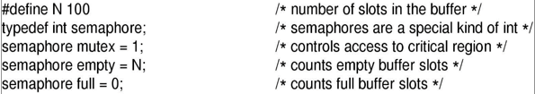
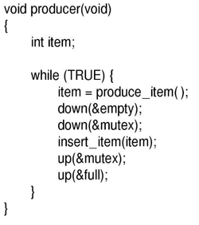
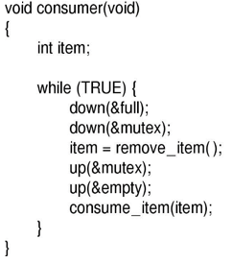
Producer & consumer

Slide 34
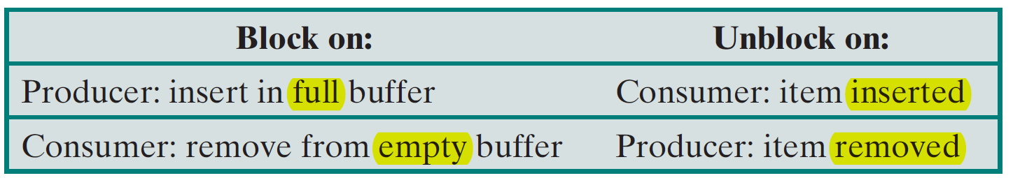
Semaphores in Producer Consumer Problem: Analysis
3 semaphores are used
full (initially 0) for counting occupied slots
Empty (initially N) for counting empty slots
mutex (initially 1) to make sure that Producer and Consumer do not access the buffer at the same time.
Here 2 uses of semaphores
Mutual exclusion (mutex)
Synchronization (full and empty)
To guarantee that certain event sequences do or do not occur

Slide 35
Semaphores: Usage
Mutual exclusion
Controlling access to limited resource
Synchronization

Slide 36
Mutual exclusion
How to ensure that only one process can enter its C.R.?
Binary semaphore initialized to 1
Shared by all collaborating processes
If each process does a down just before entering CR and an up just after leaving then mutual exclusion is guaranteed
do {
down(mutex);
// critical section
up(mutex);
// remainder section
} while (TRUE);

Slide 37

Controlling access to a resource
What if we want maximum m process/thread can use a resource simultaneously ?
Counting semaphore initialized to the number of available resources
Semaphore from railway analogy
Here is a semaphore initialized to 2 for resource control:
Non critical
Critical : 2 Cars permitted at a time
Non Critical
Value=2
Value=1
Value=0
Value=1
Value=0
Value=2

Slide 38
Synchronization
How to resolve dependency among processes
Binary semaphore initialized to 0
consider 2 concurrently running processes:
P1 with a statement S1 and
P2 with a statement S2.
Suppose we require that S2 be executed only after S1 has completed.
P1 P2
S1;
up(synch);
down(synch);
S2;

Slide 39
Semaphores: “Be Careful”
Suppose the following is done in Producer’s code
If buffer full P would block due to down(&empty) with mutex = 0.
So now if C tries to access the buffer, it would block too due to its down(&mutex).
Both processes would stay blocked forever: DEADLOCK
…
down(&empty)
down(&mutex)
…
…
down(&mutex)
down(&empty)
…
Just the order is reversed

Slide 40
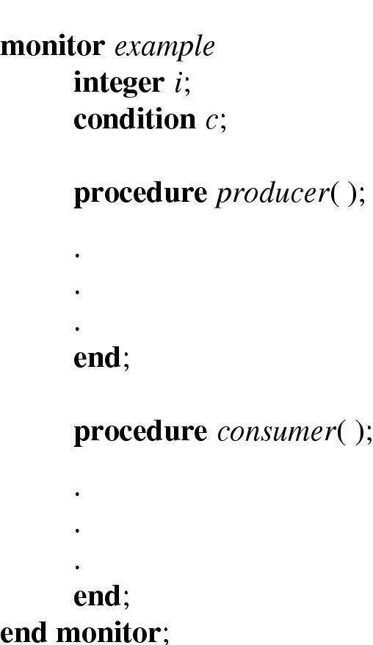
Monitors
A higher level synchronization primitive
A collection of procedures, variables and data structures grouped in a special kind of module or package.
Example of a monitor

Slide 41
Monitors
Only one process can be active in a monitor at any instant
Monitors are programming language construct, so the compiler knows they are special and can handle calls to monitor procedures differently from other calls.
Because the compiler, not the programmer, is arranging the mutual exclusion, it is safer
We also need a way to block and wakeup: Wait and Signal (done on a condition variables)

Slide 42
Monitors
wait is called on some condition variables:
Calling process is blocked
another process that had been previously prohibited from entering the monitor is allowed to enter now.
signal is called on some condition variable:
A process waiting on that CV is given the chance to get up.
Who should run? Caller or awakened one?
Alternative#1: Let newly awakened process to run suspending the caller.
Alternative#2: Process doing a signal must exit the monitor immediately i.e. signal statement may appear only as the final statement in a monitor procedure.
Alternative#3: Let the caller run and when it exits the monitor then the waiting process is allowed to start.
Note: If more than one processes are waiting on full, one of them is scheduled.

Slide 43
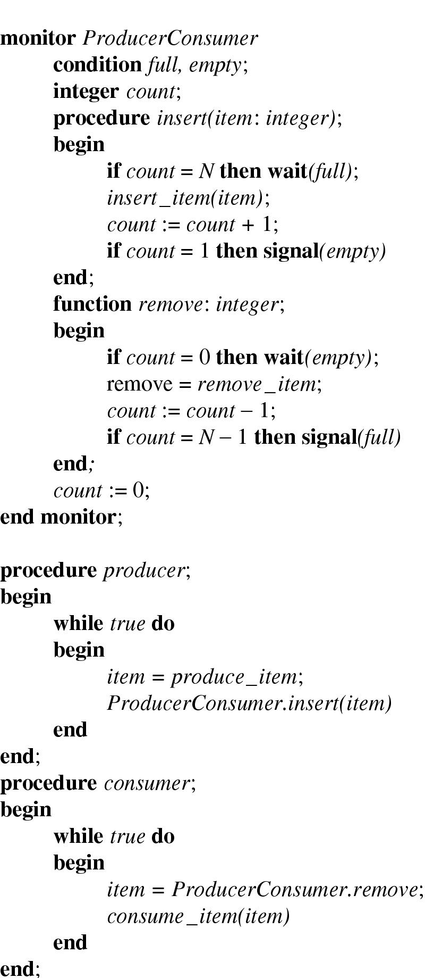
Outline of producer-consumer using Monitors
Outline of producer-consumer problem with monitors
only one monitor procedure active at one time
buffer has N slots

Slide 44
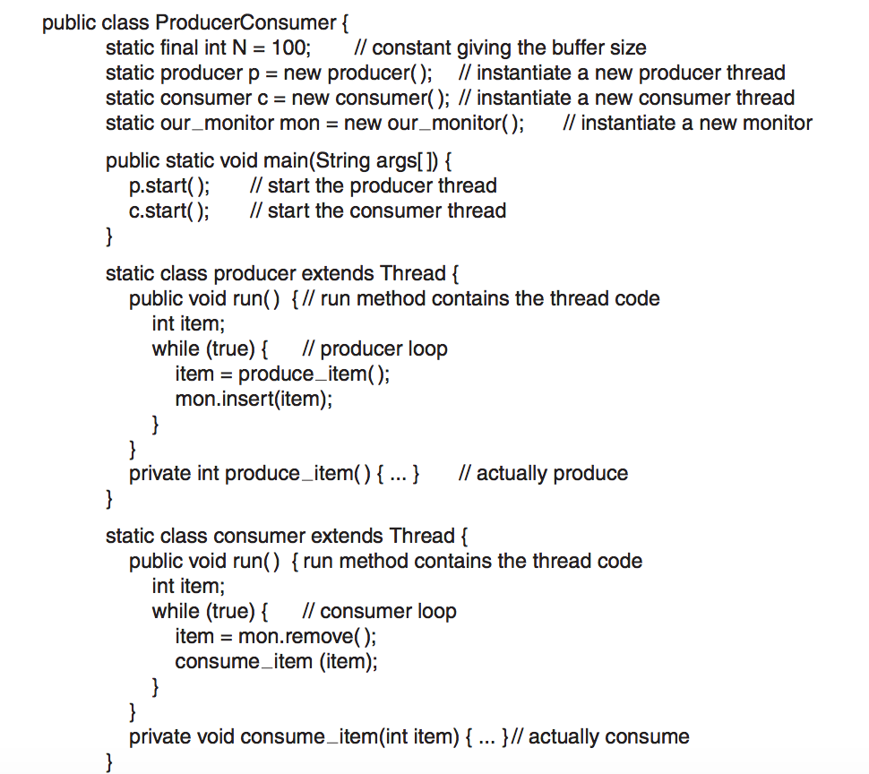
Producer-consumer solution in Java

Slide 45
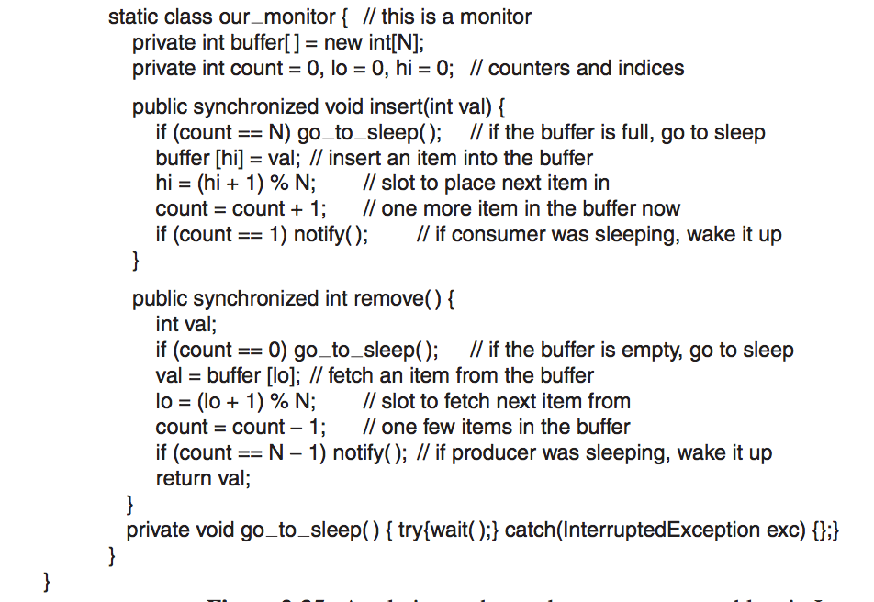

Slide 46
Problems with monitors and semaphores
Semaphores are too low level
Monitors are not usable except in a few programming languages
Designed to work in an environment having access to a common memory
Doesn’t allow information exchange among machines
None of them would work in a distributed systems (why?) consisted of multiple CPUs, each with its own private memory connected by a LAN.

Slide 47
Message Passing
solution to the problem of semaphores and monitors w.r.t distributed systems
A method of IPC that uses two primitives
send and receive: system calls.
send(destination, &message)
receive(source, &message)
If no message is available:
The receiver can block until one arrives
Return immediately with an error code

Slide 48
Message Passing
Challenges (Study of Computer Networks)
Messages can be lost by the network.
Acknowledgement and retransmission issue.
Process naming.
Authentication.
Performance issue.

Slide 49
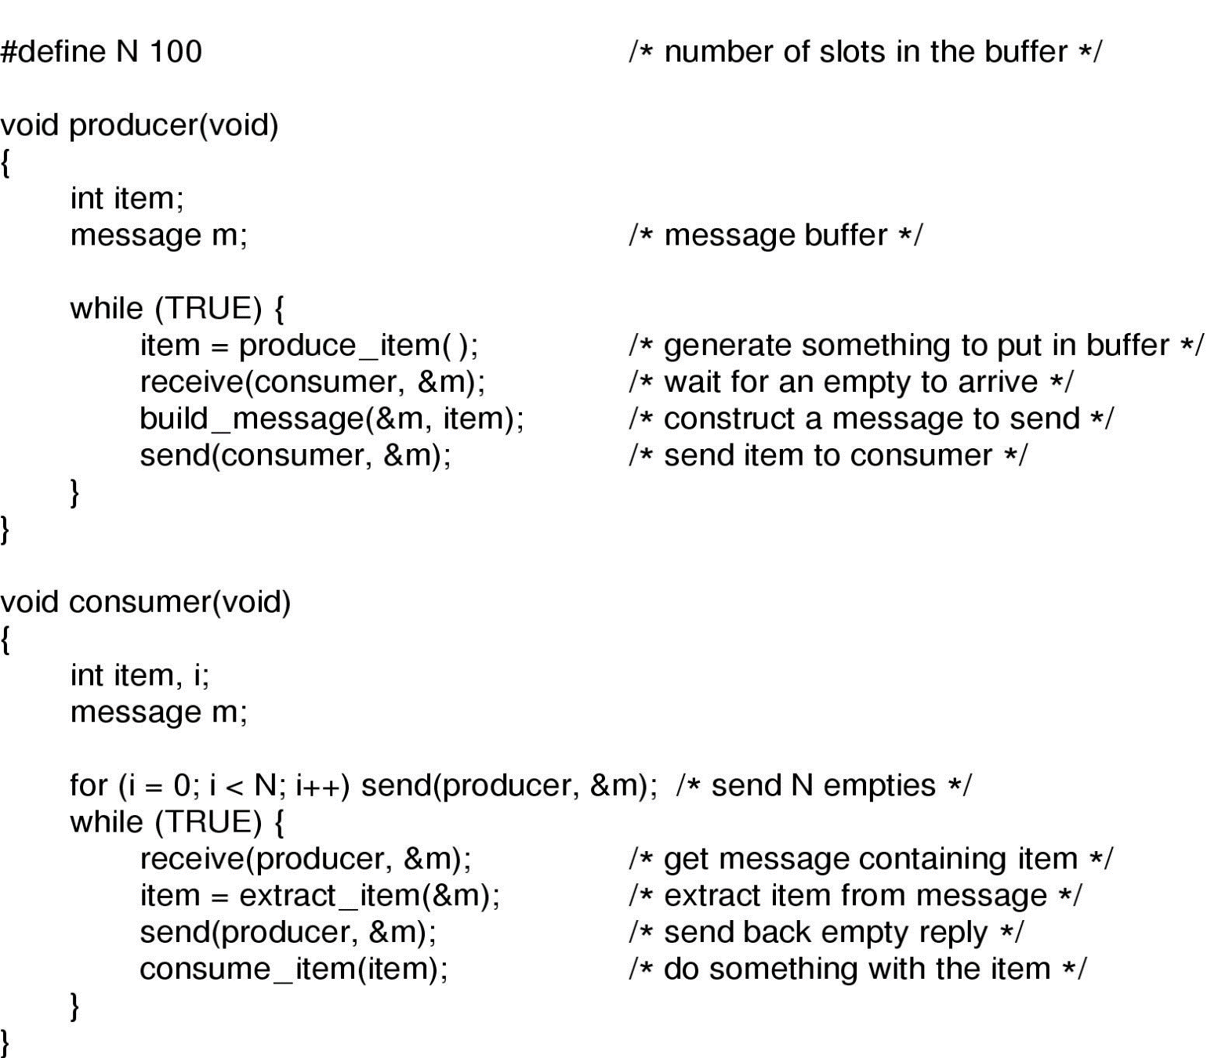
Producer Consumer with Message Passing
Assumptions:
All messages are of same size
Messages sent but not yet received are automatically buffered
The producer-consumer problem with N messages

Slide 50
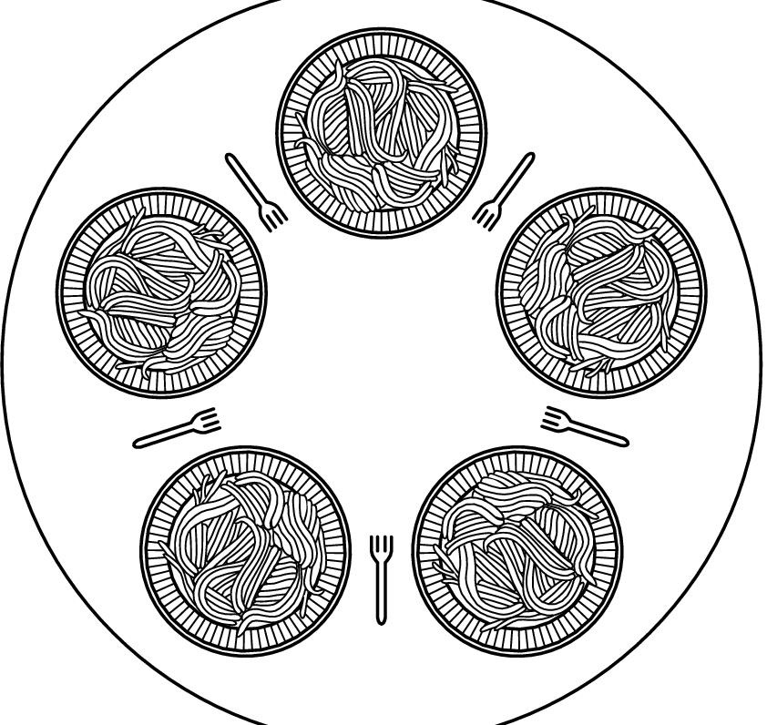
Dining Philosophers
An example problem for process synchronization
Philosophers spend their lives thinking and eating
Don’t interact with their neighbors
When get hungry try to pick up 2 chopsticks (one at a time in either order) to eat
Need both to eat, then release both when done
How to program the scenario avoiding all concurrency problems?

Slide 51
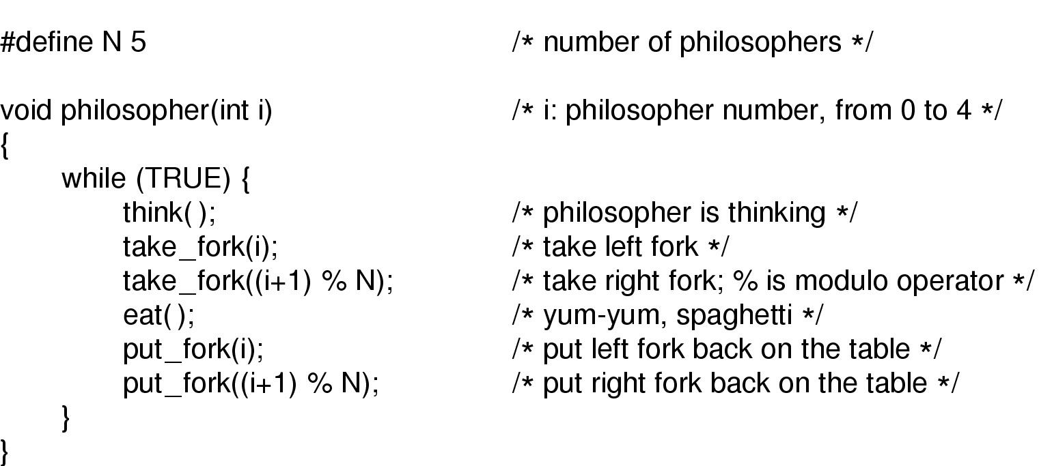
Dining Philosophers: A Solution

Slide 52
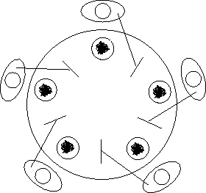
Dining Philosophers: Problems with Previous Solution
Deadlock may happen
Does this solution prevents any such thing from happening ?
Everyone takes the left fork simultaneously

Slide 53
Dining Philosophers: Problems with Previous Solution
Tentative Solution:
After taking left fork, check whether right fork is available.
If not, then return left one, wait for some time and repeat again.
Problem:
All of them start and do the algorithm synchronously and simultaneously:
STARVATION (A situation in which all the programs run indefinitely but fail to make any progress)
Solution: Random wait; but what if the most unlikely of same random number happens?

Slide 54
Another Attempt, Successful!
void philosopher(int i)
{
while (true)
{
think();
down(&mutex);
take_fork(i);
take_fork((i+1)%N);
eat();
put_fork(i);
put_fork((i+1)%N);
up(&mutex);
}
}
Theoretically solution is OK- no deadlock, no starvation.
Practically with a performance bug:
Only one philosopher can be eating at any instant: absence of parallelism

Slide 55
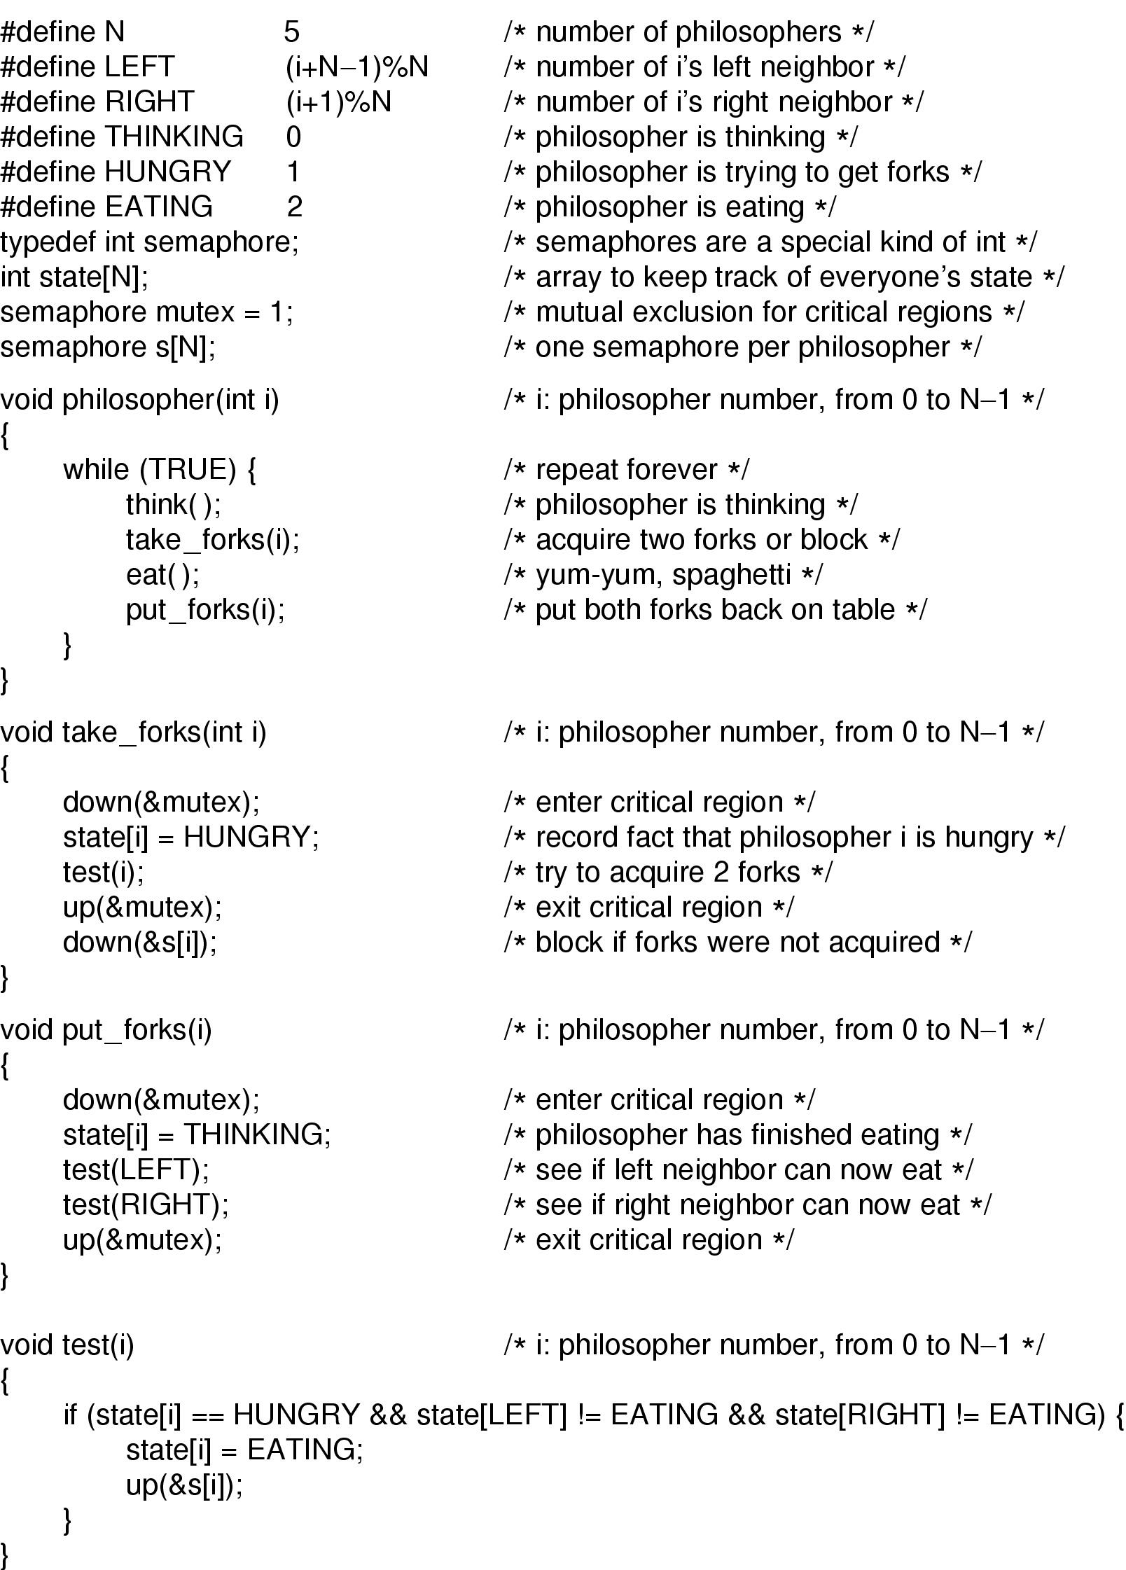
Final Solution part 1

Slide 56
Final Solution Part 2

Slide 57
The Readers and Writers Problem
Dining Philosopher Problem: Models processes that are competing for exclusive access to a limited resource
Readers Writers Problem: Models access to a database
Example: An airline reservation system- many competing process wishing to read and write-
Multiple readers simultaneously- acceptable
Multiple writers simultaneously- not acceptable
Reading, while write is writing- not acceptable

Slide 58
The Readers and Writers Problem
First variation – no reader kept waiting unless writer has permission to use shared object
Second variation – once writer is ready, it performs write ASAP

Slide 59
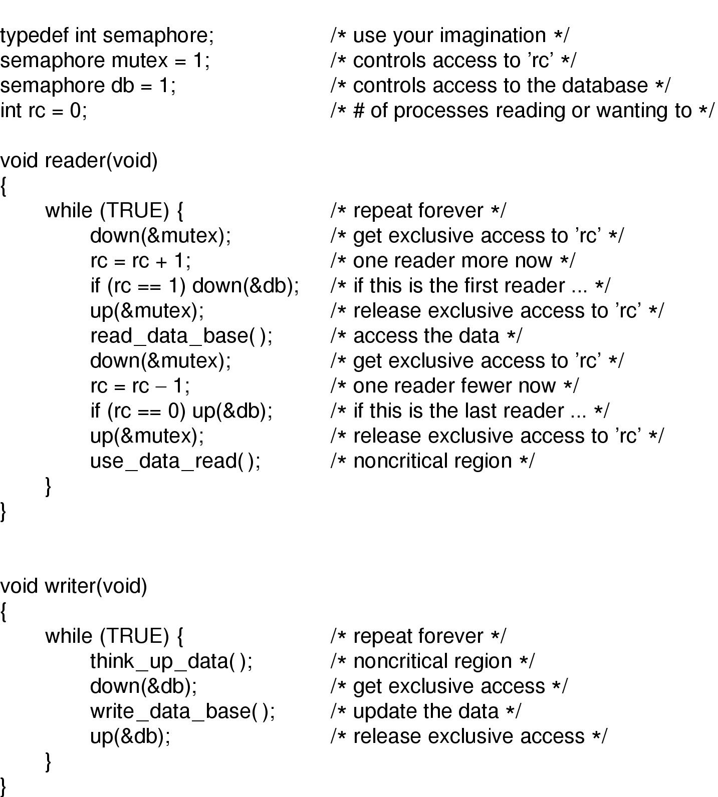
A solution to the readers and writers problem

Slide 60
Issue regarding the solution
Inherent priority to the readers
Say a new reader arrives every 2 seconds and each reader takes 5 seconds to do its work. What will happen to a writer?
Issue regarding second variation
Writer don’t have to wait for readers that came along after it
Less concurrency, lower performance

Slide 61
Thanks for your sincerity

